Slide 1

Music Player using Linked List
Presented by:
Samarth Agarwal
Mohit Soni
Mohit Bharti

Slide 2
Content
Why Linked List not array
Introduction to Linked List
Insertion
Deletion
Searching
How it is implemented in music player

Slide 3
Why Linked List not Array
Arrays can be used to store linear data of similar types, but arrays have the following limitations.
1) The size of the arrays is fixed: So we must know the upper limit on the number of elements in advance. Also, generally, the allocated memory is equal to the upper limit irrespective of the usage.
2) Inserting a new element in an array of elements is expensive because the room has to be created for the new elements and to create room existing elements have to be shifted.
Advantages over arrays
1) Dynamic size
2) Ease of insertion/deletion

Slide 4
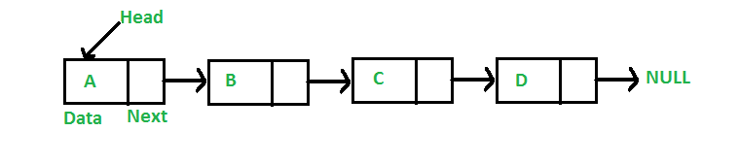
Introduction to Linked List
A linked list is a linear data structure, in which the elements are not stored at contiguous memory locations. The elements in a linked list are linked using pointers as shown in the below image:
In simple words, a linked list consists of nodes where each node contains a data field and a reference(link) to the next node in the list.

Slide 5
A linked list is represented by a pointer to the first node of the linked list. The first node is called the head. If the linked list is empty, then the value of the head is NULL.
Each node in a list consists of at least two parts:
1) data
2) Pointer (Or Reference) to the next node
Basic Operations of Linked List
Construction: Allocate and initialize the head node.
Empty: Check whether the list is empty
Insertion: Add an element to the list at any point
Deletion: Remove an item from the list at any point

Slide 6
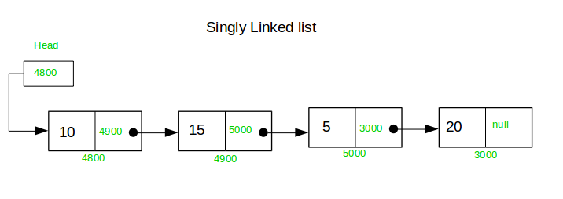
Types of Linked List
Singly Linked List:
-Begins with a pointer to the first node.
-Terminates with a NULL pointer
-Only traversed in one direction

Slide 7
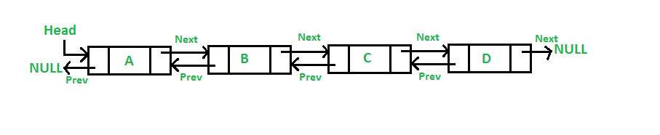
2) Doubly Linked List:
-Each node has a forward pointer and a backward pointer
-allow traversal in both forward and backward direction.

Slide 8
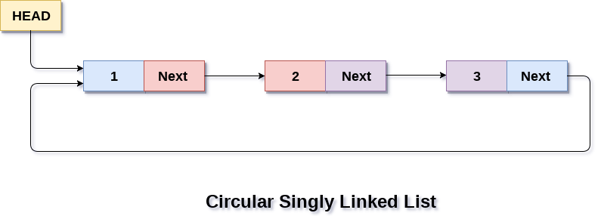
3) Circularly Linked list:
-Last item contains link of the first element as next.
-allow traversal usually in one direction only.

Slide 9
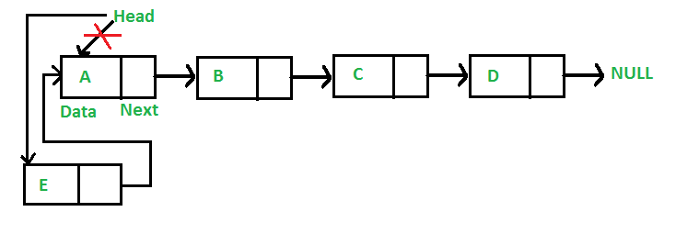
Linked List Insertion
Inserting a Node at Beginning: Inserting a node at the start of the list is a four-step process. In this process, the new node is always added before the head of the given Linked List and the newly added node becomes the new head of the Linked List.
Process :
Allocate Node
Put in the data
Make next of new node as head
move the head to point to the new node
Time Complexity - O(1)

Slide 10
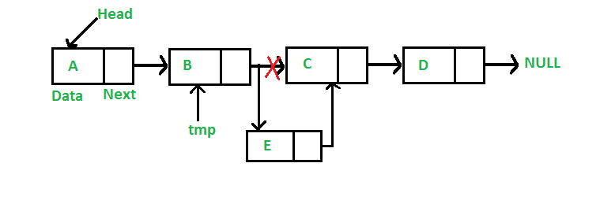
Linked List Insertion
Inserting a Node after given Node: Inserting a Node after a given Node One have to first allocate the new Node and change the next pointer of the newly created node to the next of the previous node and the next pointer of the previous node to point to the newly created node.
Process :
check if the given prev_node is NULL
allocate new node
put in the data
Make next of new node as next of prev_node
move the next of prev_node as new_node
Time Complexity - O(1)

Slide 11
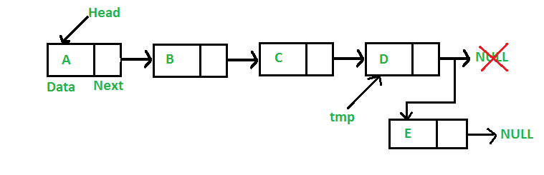
Linked List Insertion
Inserting a Node at the End: Inserting a new Node at the last of a Linked list is generally a six step process in total. The new node is always added after the last node of the given Linked List.
Process :
allocate node
put in the data
This new node is going to be the last node, so make next of it as NULL
If the Linked List is empty, then make the new node as head
Else traverse till the last node
Change the next of last node
Time Complexity - O(n)

Slide 12
Linked List Deletion
there can be many situations when it comes to deleting a Node from a Linked List. Some of the most frequent such situations are:
Given the data value of a Node, delete the first occurrence of that data in the list .
Find previous node of the node to be deleted.
Change the next of previous node.
Free memory for the node to be deleted.
Given the position of a node, delete the node present at the given position in the list.
If the node to be deleted is the root node, we can simply delete it by updating the head pointer to point to the next of the root node.
To delete a node present somewhere in between, we must have the pointer to the node previous to the node to be deleted. So if the position is not zero, run a loop position-1 times and get the pointer to the previous node and follow the method discussed in the first situation above to delete the node.
Given a pointer to the node to be deleted, delete the node

Slide 13
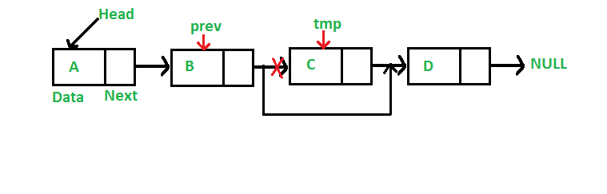
Linked List Deletion
To delete a node from linked list, we need to do following steps.
1) Find previous node of the node to be deleted.
2) Change the next of previous node.
3) Free memory for the node to be deleted.

Slide 14
Searching In Linked List.
Searching is performed in order to find the location of a particular element in the list.
Eg:- 14->21->11->30->10
key 1= 14, key 2 = 15
Time complexity of searching an element in the linked list is O(n).

Slide 15
Algorithm of Searching In Linked List
1) Initialize a node pointer, current = head.
2) while current is not NULL
a) current->key is equal to the key being searched return true.
b) current = current->next
3) Return false

Slide 16
Music Player Implementation using Linked List
Songs in music player are linked to previous and next song. you can play songs either from starting or ending of the list.
-> We can use Doubly linked list.
->Skip Backward/Forward
->Play Next Track
->Append
->Beginning/End

Slide 17


